Slide 1
Welcome

Slide 2
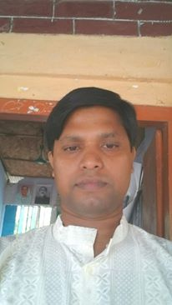
Presented by
MD. Afzal Hossain
Asst. teacher,
2 No. Pangashia Govt. Primary School,
Kalkini, Madaripur.

Slide 3
Introducing of lesson
ENGLISH FOR TODAY
Class : Three
Lesson title : What do they do?
Lesson unit : 23
Date: 2/11/2016
Time : 35 minutes

Slide 4
Learning outcomes
Students will be able to
5.1.3 read the texts.
8.1.1 write words from the textbook or model
10.1.1 write short and simple paragraphs by answering a set of questions.

Slide 5
Let’s enjoy a video

Slide 6
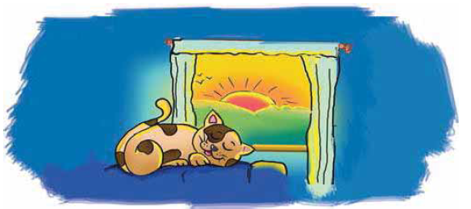
Lesson Declaration
What do they do (cat)?

Slide 7
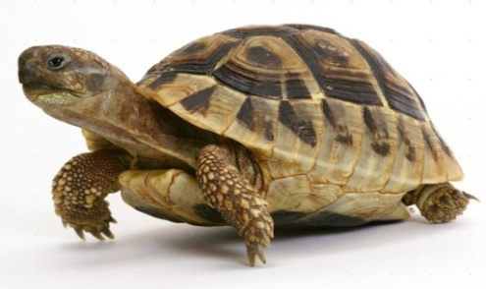
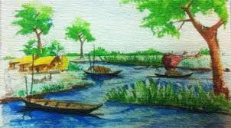
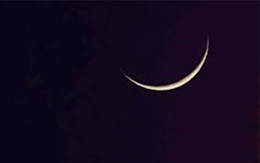
Quick-rapid.
It runs quick.
Slow-delay.
It moves slow.
Early- begging of the day.
I get up early.
Late- end of the day.
She comes late.

Slide 8
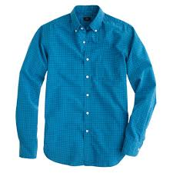
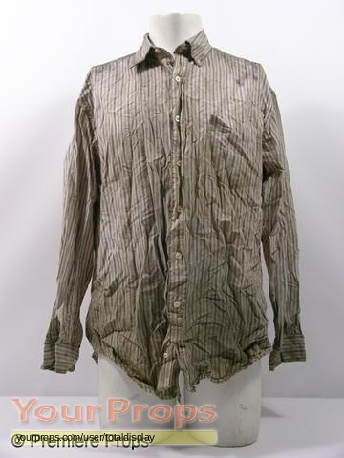
Clean-pure.
Drink clean water.
Dirty- with dust.
The shirt is dirty.
Lazy- working.
He is lazy.
Active- not working.
You are active.

Slide 9
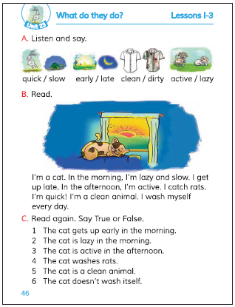
Open your text book and see page at 46.

Slide 10
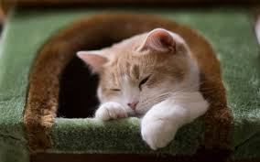
I’m a cat.In the morning,I’m lazy and slow.I get up late.

Slide 11
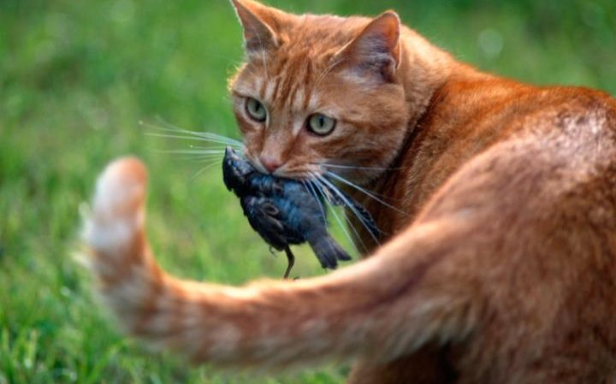
In the afternoon , I’m active. I catch rats. I’m quick!

Slide 12
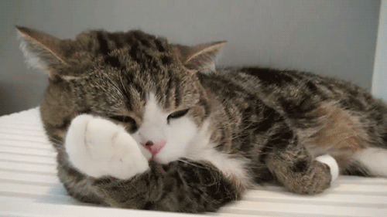
I’m a clean animal. I wash myself everyday.

Slide 13
Group Work
Write opposite word
Group-A
quick, active
Group-B
early, clean
Group-C
morning, lazy

Slide 14
Evaluation
Write 5 sentences about your favourite
animal by answering following questions:
What is your favourite animal?
How does it look?
Why do you like it?
What does it eat?
What is it’s nature?

Slide 15
Good Bye

